Slide 1
Phase 3
IDEATE
Notes:
Review the previous weeks assignment for 20 – 30 mins before beginning the presentation. This week is to make the students learn about looking for existing solutions and making concepts and also representing them.

Slide 2
SURVEY
Existing Product Search
Prior Art Search
Patent Search
Parallel Product Search
What?
Notes:
It is a search tool for existing solutions.
Helps better understand what can be done, by seeing what has been done.
Make the students to write down the information provided.
Make the students take a note of the information on IPR.
What is an Intellectual Property? What is Patent?
*Intellectual Property is the property that includes intangible aspects like Ideas, Creative thoughts, etc. It deals with Human Mind’s creations. It is given in the form of Patents, Copy Rights, Trademarks, etc.
*Having it gives rights to oppose unfair competition, when dealing with creating intellectual good like Ideas on products, services, etc. Law gives information rights and usage rights to the owner, for the product for a limited time period. Having these rights ensure that others don’t copy, sell, or use one’s intellectual property.
*One can profit from these rights by leasing the information / goods to the others.
*The incentives are given to trigger intellectual goods and promote innovation, as a solution to a technological problem, in a NEW, NOT OBVIOUS and HAVING AN INDUSTRIAL APPLICABILITY.
*Intellectual property helps new product development by protecting the newly generated ideas as registered under a Government Body and prohibits other individual to use them without permission from the owner.
*Example: Tirupati Laddu, can’t be made anywhere in the world, other than on the hills of Tirupati.

Slide 3
SURVEY
Existing Product Search
Prior Art Search
Patent Search
Parallel Product Search
Why?
Notes:
Need for Searching – Ensure originality of your concept, See what has been done previously, Helps think of other possible solutions.
What is a Patent?
Why is it important?
Explain it’s role in New Product Development.
Make the students to write down the information provided.

Slide 4
SURVEY
Existing Product Search
Prior Art Search
Patent Search
Parallel Product Search
How?
Notes:
What are Keywords?
How to identify multiple keywords for one product?
How to do a priority search on Google Patents?
Where else can we search?
Instructor is advised to showcase on internet, how to look for existing solutions and parallel scenarios for collecting required information.
Make the students to write down the information provided.

Slide 5
Review
Problem Statement
What, Why and How to Survey?
Notes:
Review the activities in the class.

Slide 6
CONCEPTUALIZATION
Classroom Activity : 20 +20 mins
BRAINSTORMING SESSION
Brainstorming is a Process of generating new and creative ideas / solutions to solve a problem, through Group Discussions with acceptance to any kind of suggestions / inputs from the group of participants. Every participant is benefitted by improving an adaptive mind-set that gives an additional perspectives to look at a problem from.
Notes:
Ensure that the students are seated in a group, around the table and are contributing to the thought.
As a classroom activity, the students shall be given a simple problem – like Potato peeling, and are asked to think of different kinds of solutions they can come up with as a group.

Slide 7
CONCEPTUALIZATION
Classroom Activity : 20 mins
BRAINSTORMING SESSION – RULES:
Focus on number / quantity of ideas
Never criticize
Accept any kind of suggestion, however bizarre
Think and appreciate uncommon
Combine and improve
Notes:
Preparation:
Topic shall be kept Thinking about.
An idea or a thought might come up. It becomes your insight.
Any thought coming out of your mind, however unrelated or crazy, must be put on paper in the form of a sketch / writing.
Evaluate the thought based on originality, feasibility, etc.
Turn your thought / idea into concept.
Come up with as many concepts as possible.

Slide 8
CONCEPTUALIZATION
Classroom Activity : 20 mins
BRAINSTORMING SESSION – TOOL:
S - SUBSTITUTE
C - COMBINE
A - ADAPT
M - MODIFY – MINIMIZE / MAGNIFY
P - PUT TO ANOTHER USE
E - ELIMINATE
R – REUSE / REORGANISE / REVERSE
Notes:
S – Substitute: Material, Other Product, Process, Rules, Can this replace another Product? etc.
C – Combine: Purposes, Objectives, Products, Resources, etc.
A – Adapt: What else is like this product? In what other context can this product be used? How can this product behave in another specific context? Etc.
M – Modify / Magnify / Minimize: Aesthetics -Shape, Look, Feel, Manufacturing - Strength of parts, Assembly, etc.
P – Put to another Use: Usability in another context / scenario, etc.
E – Eliminate / Elaborate: Streamline, Simplify, Eliminate useless parts, functions, How can we make it lighter, faster and smaller? Etc.
R – Reuse / Reorganise / Reverse: Sequence of actions, How to do the exact opposite of what is being done? Etc.

Slide 9
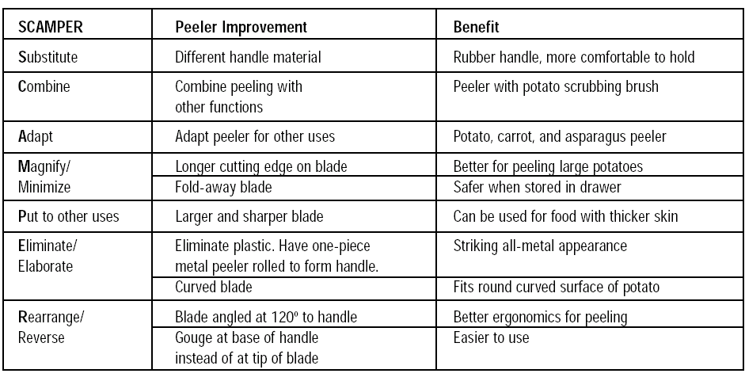
Applying SCAMPER TOOL ON A POTATO PEELER
Notes:
Show the students on how to apply SCAMPER Tool on a simple product like Potato Peeler, as an example.
Also, give 10 minutes and ask them to try and sketch the peeler according to benefits being presented on a fresh paper.
After 5 minutes, reveal the next slide – the actual model developed through the process.

Slide 10
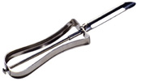
Applying SCAMPER TOOL ON A POTATO PEELER
Notes:
Explain how SCAMPER Tool has benefitted in product development.
Same concept can be thought of and can be made in different ways. We all think differently. Everyone perceives things in their comfort zone. That’s why sketching is important to communicate your idea effectively without leaving anything to imagination.
“A picture can communicate what a 1000 words can’t.”
Sketching acts as an effective visual communication tool to express and make people understand your idea about a product.
Also, share the notes – ‘ PDS - Sketching - Object Drawing.docx’ to the WhatsApp group.
Ask them to go through the document and practice different lines and circles – Also add practice photos to the Ppt.

Slide 11
Review
Need / Problem Prioritization
Problem Statement
Prior Art Search
Brainstorming – SCAMPER
Sketching – Importance and Practice Assignment.
Notes:
Review the activities in the class.

Slide 12
Assignment 3 Marks:14
Make a Power Point Presentation on your Survey / Search Results , Conceptualization (By Applying SCAMPER tool on search results), and Sketching, in the shared format.
Notes:
Share ‘PDS - Assignment - 3 - Survey, Conceptualization & Sketching - Template.pptx’ to the WhatsApp group.

